Slide 1
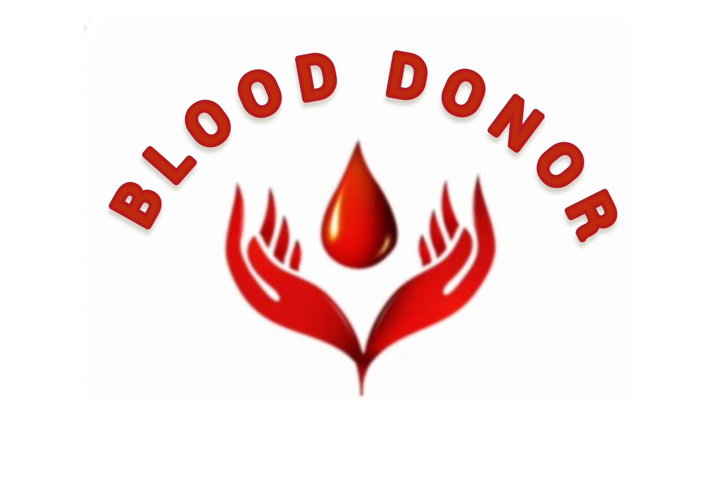

Slide 2
Optimizing Blood Donation: A Comprehensive Overview of Our Innovative App

Slide 3
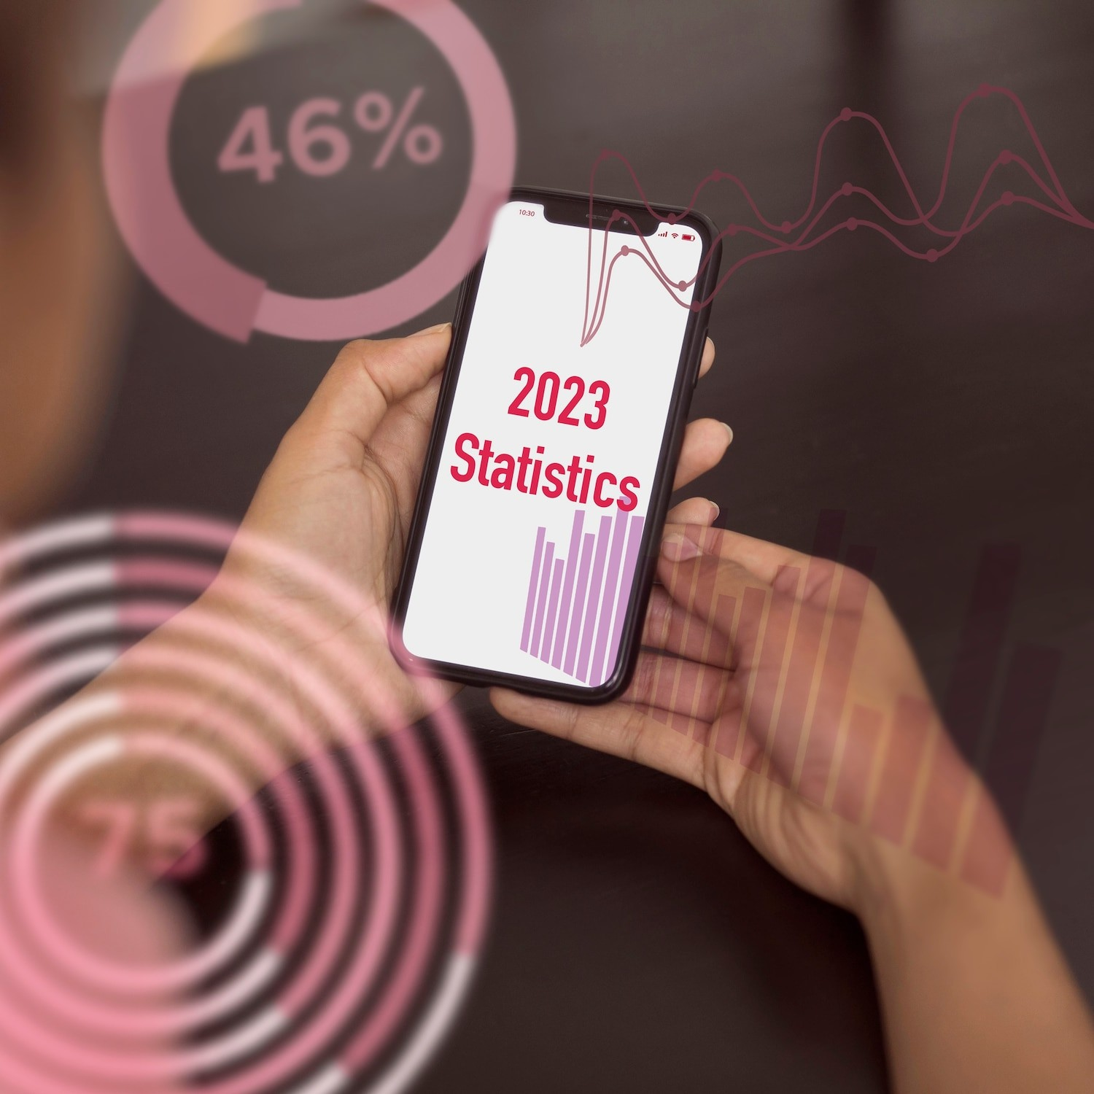



Introduction
Welcome to our presentation on Optimizing Blood Donation! We will explore the innovative features of our app that aim to the blood donation process and donor participation.
Our app is designed to donors with blood banks and provide real-time updates on donation opportunities.

Slide 4
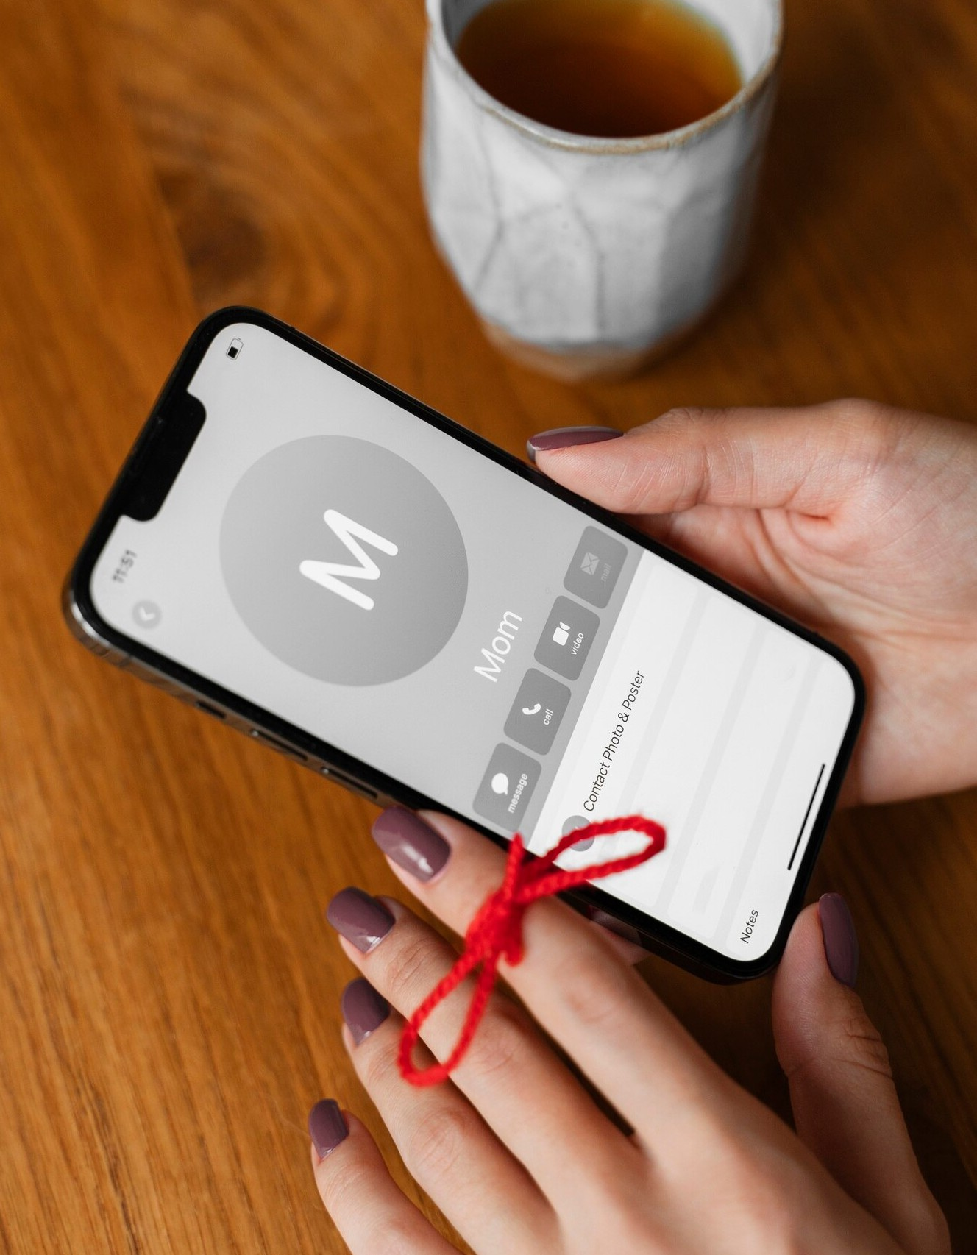


Donor Registration
Our app offers a simple and secure registration process for donors. By providing essential information and preferences, donors can easily donation appointments and receive personalized . The app also
allows users to track their donation history and impact.

Slide 5
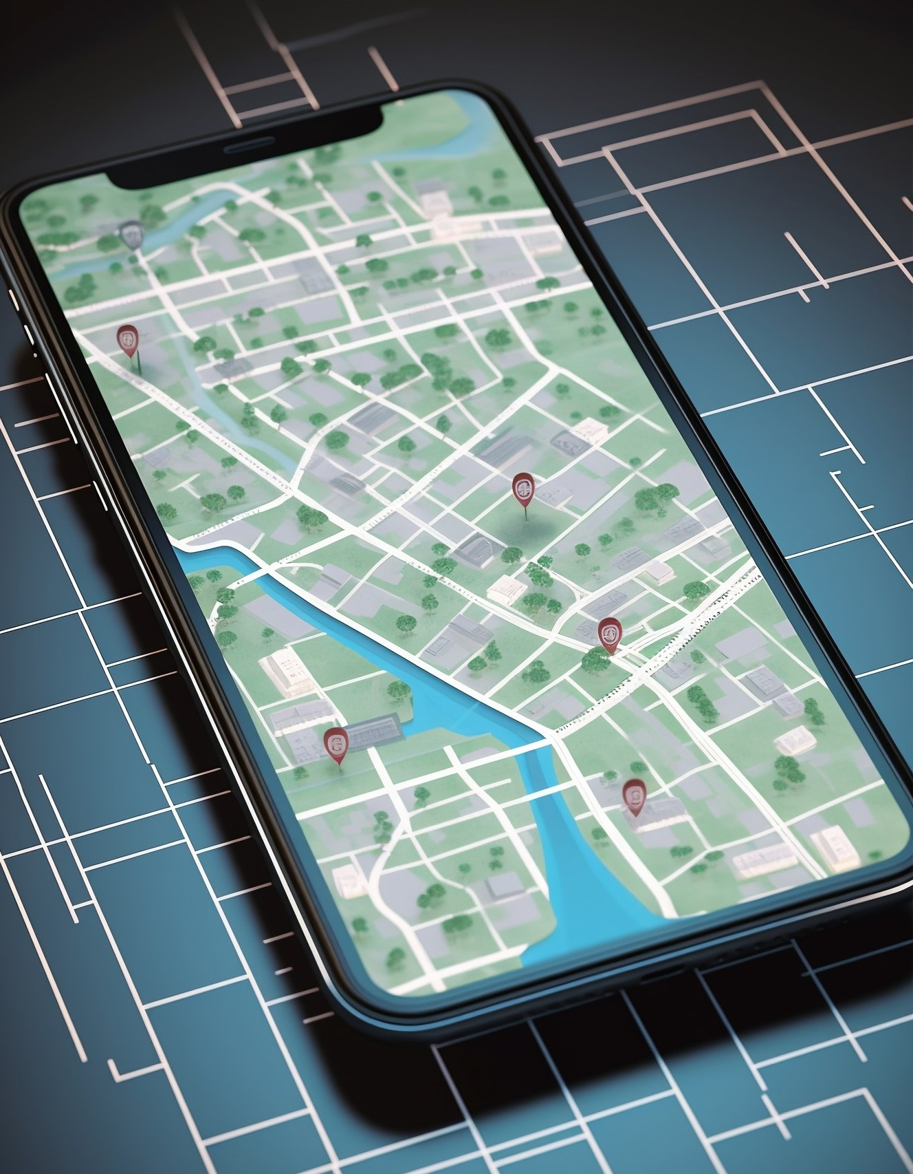



Blood Bank Integration
We have with leading blood banks to integrate their services into our app. This enables users to locate nearby blood banks, check real-time
levels, and receive urgent for speciﬁc blood types. The app facilitates seamless communication between donors and blood banks.

Slide 6



Community Engagement
Our app fosters a sense of by enabling users to share their donation experiences and achievements on social media platforms. Additionally, it provides educational resources and stories to encourage new donors to join the cause. Through this, we aim to create a supportive and engaged donor community.

Slide 7
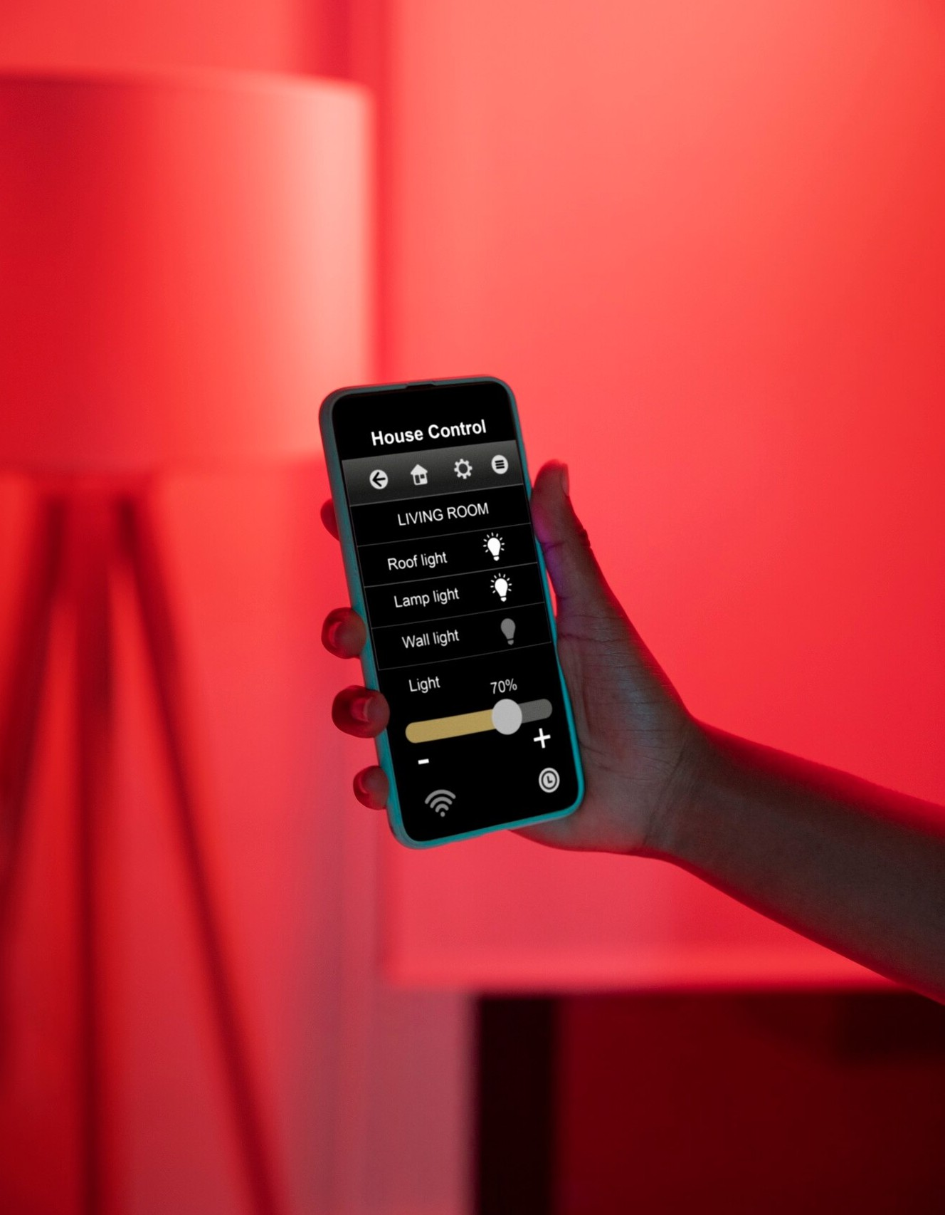

Real-time Updates
One of the key features of our app is the provision of real-time on blood donation events, urgent needs, and donation milestones. Users receive instant notiﬁcations about nearby donation drives, emergency appeals, and the impact of their contributions. This ensures timely and relevant information for donors.

Slide 8



Conclusion
In conclusion, our innovative app is poised to revolutionize the blood donation landscape by donors, enhancing blood bank operations, and fostering a strong sense of community.
With its user-friendly interface and comprehensive features, our app is set to
make a meaningful on blood donation efforts worldwide.

